Slide 1
Ethical Assurance & Certification of
Machine Learning Algorithms
Under DO-178C — conference presentation
Oliver Haythornthwaite · 28 May 2026
Thesis: MLA is certifiable only as a controlled system component, bounded by deterministic architecture and backed by auditable evidence.
1

Slide 2
Current state of certification
Aviation AI assurance is converging, but no single “MLA certification recipe” exists
DO-178C baseline
System safety baseline
AI/ML guidance
Authority engagement
Mature lifecycle evidence for airborne software: requirements, verification, coverage, independence, CM and QA.
ARP4754A/B and ARP4761 remain the route for hazard-driven system assurance and safety case closure.
EASA, FAA, UK CAA and MAA guidance recognises additional needs: learning assurance, explainability, data, drift and ethics.
Early engagement is essential because first-of-type MLA assurance introduces atypical review points and evidence needs.
Implication: the field is not starting from zero — it is adapting established assurance discipline to learned behaviour.
External context: EASA AI Concept Paper Issue 2 (2024); FAA AI Safety Assurance Roadmap (2024); UK CAA AI principles/strategy; MAA/RN/2025/04.
Ethical Assurance & Certification of MLA under DO-178C
2

Slide 3
The certification gap
DO-178C evidence remains necessary — but is insufficient for learned behaviour
Traditional software assurance
• Requirements-based tests
• Structural coverage
• Tool qualification
• CM / QA / independence
MLA-specific assurance
• Data provenance & representativeness
• ODD coverage & distribution shift
• Robustness & uncertainty
• Explainability, drift & security
Assurance bridge
The document argues that MLA must not be treated as a special exception. It must be controlled, constrained, verified and monitored as part of the integrated system safety case.
Document abstract and preface: DO-178C is a baseline; additional evidence is required for model behaviour, data and operational drift.
Ethical Assurance & Certification of MLA under DO-178C
3

Slide 4
Purpose, scope and boundary conditions
Start by narrowing the problem before claiming certifiability
In scope
Out of scope / not approved by this argument
Supervised, offline-trained ML models
Classifiers, perception, decision support, anomaly detection and optimisation
Airborne and aviation-influencing systems including ground support, mission planning, maintenance and training
Adaptive in-service learning
Autonomous lethal decision-making
Uncontrolled online model updates
Opaque third-party foundation-model dependency
Any deployment without agreed certification and safety basis
Default stance: freeze the model, configuration-control the datasets/tools/parameters, bound the output, and treat retraining as a formal change.
Ethical Assurance & Certification of MLA under DO-178C
4

Slide 5
Policy ecosystem
The report links assurance claims to defence, civil aviation and software assurance sources
MOD dependable AI / safety / HFI
Governance, ethics, human factors and safety accountability
DO-178C + DO-330/331/332
Software lifecycle, tools, model-based development and OO techniques
ARP4754 / ARP4761
System development, FHA/PSSA/SSA and safety case closure
EASA / FAA / CAA / MAA AI guidance
Learning assurance, explainability, transparency, oversight and staged adoption
Key message for the audience: policy is already pointing toward a safety-case approach, not a generic model-accuracy argument.
Based on the document policy-context table and policy-traced arguments.
Ethical Assurance & Certification of MLA under DO-178C
5

Slide 6
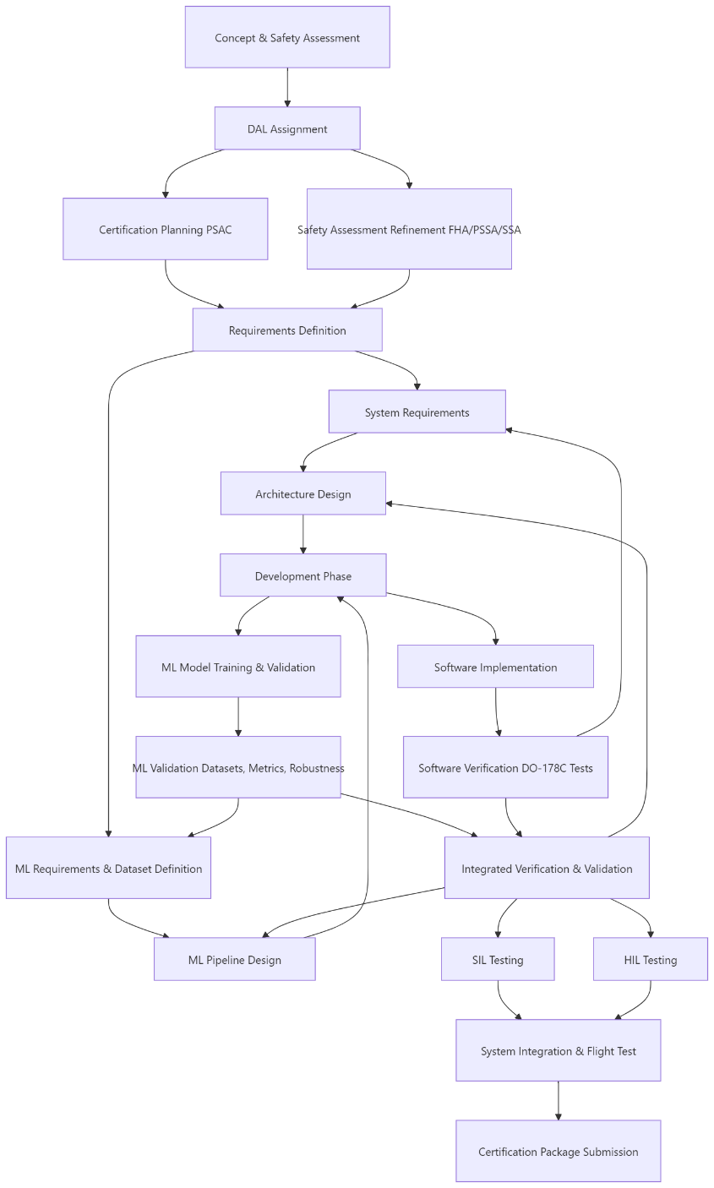
High-level certification flow
Treat the flow as iterative, not as a simple waterfall schedule
Concept and safety assessment define the certification basis and DAL early.
ML requirements and dataset definition must sit alongside system requirements.
Model training, software implementation and integrated verification converge before SIL, HIL and flight test.
Authority engagement, issue closure and evidence funding are programme dependencies, not late-stage admin.
Piecemeal narrative: introduce each box as an evidence decision point. The question is not “did the model perform?” but “does the evidence still apply to the configured system?”
Document Figure 1, p.11.
Ethical Assurance & Certification of MLA under DO-178C
6

Slide 7
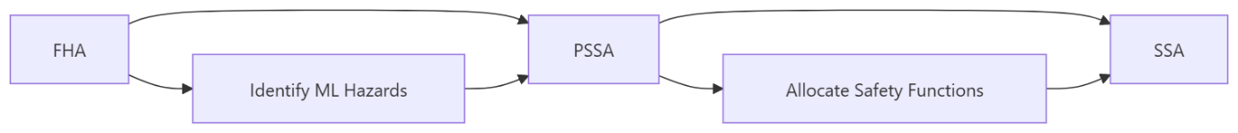
Safety assessment first
MLA hazards must be explicit before safety functions are allocated
A suitability matrix gives the audience a concrete decision screen.
High-criticality, opaque, unbounded or no-fallback cases should be de-scoped, downgraded or isolated.
The safety architecture — not model confidence alone — determines whether MLA can be credited.
Factor
Low concern
Medium concern
High concern
Function criticality
Advisory
Influences operator
Affects control
Model authority
Recommendation
Bounded decision
Autonomous action
Need for action: projects need a repeatable “go / constrain / stop” mechanism before AI becomes embedded in the design.
Explainability
Clear rationale
Partial rationale
Opaque output
ODD containment
Well defined
Partially monitored
Poorly bounded
Fallback
Deterministic
Verified human
No fallback
Document Figure 2, p.12 and Table 2, p.13.
Ethical Assurance & Certification of MLA under DO-178C
7

Slide 8
Architecture principle
Make the system boundary deterministic even when the model is statistical
Constrained
inputs
MLA model
(frozen baseline)
Runtime
monitor
Safe output
interface
Fallback / rejection / degraded mode / human review
Isolate and partition MLA components like other safety-related items.
Expose safely interpreted information: enumerated states, mapped classes or constrained confidence bands.
Verify rejection logic, fallback paths and monitor behaviour as part of the safety architecture.
Range limits alone do not demonstrate contextual validity or safe recovery.
Ethical Assurance & Certification of MLA under DO-178C
8

Slide 9
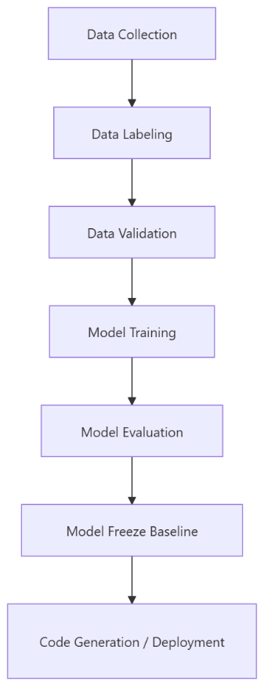
MLDevOps for certification
A controlled assurance pipeline, not a rapid model-improvement loop
ML
Datasets, provenance, ODD coverage, bias, training configuration, robustness and known failure modes
DEV
Interfaces, monitors, deterministic safety controls, fallback, integration and portability
OPS
Release baselines, evidence packs, drift monitoring, change control and continued approval
The pipeline must produce evidence as a first-class output: datasets, tools, parameters, environment definitions and model baselines must be reconstructable.
Document model implementation and MLDevOps sections, pp.14–18.
Ethical Assurance & Certification of MLA under DO-178C
9

Slide 10
Specific recommendations: design
Design the MLA as a bounded system item, not a free-standing algorithm
Modular item
Allocate explicit requirements, interfaces, input constraints and output meanings to the MLA component.
Monitor + fallback
Design runtime monitors, rejection logic, degraded modes and verified fallback paths from the outset.
Deterministic boundary
Expose only safely interpreted outputs: enumerated states, mapped classes or constrained confidence bands.
Suitability gate
If criticality, autonomy, opacity or ODD uncertainty is high, de-scope, downgrade or isolate the function.
Isolation & partitioning
Use loose coupling, partitioning and redundancy where the safety assessment requires it.
Design test for adoption: can the surrounding architecture keep the aircraft or aviation system safe when the model is wrong, uncertain, stale, unavailable or adversarially influenced?
Drawn from Architecture Design and suitability matrix recommendations, pp.13–14.
Ethical Assurance & Certification of MLA under DO-178C
10

Slide 11
Specific recommendations: implementation
Make repeatability and configuration control part of the model build
Data and model build
Deployment and environment
Validated, configuration-controlled datasets
Documented provenance, ownership, licensing and suitability
Bias, imbalance, under-representation and over-representation analysis
Model architecture, hyperparameters, tooling and environment baselines
Repeatable training pipeline with reconstructable outputs
Demonstrate functional equivalence between development and target-equivalent environments
Analyse portability where GPUs, TPUs or high-memory embedded processors are used
Control preprocessing, post-processing, model files, thresholds and generated artefacts
Prevent technical debt from compromising verification or evidence traceability
Freeze model baselines before certification evidence is credited
Implementation recommendation: establish the MLDevOps/CAS pipeline before substantive model development, so evidence is generated regressively rather than reconstructed after the fact.
Drawn from Model Implementation and MLDevOps process sections, pp.14–18.
Ethical Assurance & Certification of MLA under DO-178C
11

Slide 12
Specific recommendations: testing
Verify both model performance and safe integrated behaviour
Unit
Preprocessing, feature extraction, input validation, post-processing, confidence handling, monitor logic, model loading, boundary values and malformed inputs.
SIL
Nominal scenarios, edge cases, degraded data, simulated sensor failures, out-of-distribution inputs and regression datasets.
HIL
Timing, memory, processing constraints, bus behaviour, sensor effects and target-equivalent hardware performance.
Flight
Real-world validation, HMI assessment, certification data collection, clear test boundaries, fallback procedures, independent monitoring and abort criteria.
Testing recommendation: demonstrate safe system response when the model is correct, incorrect, uncertain, unavailable, degraded or exposed to unexpected inputs.
Drawn from Verification of the Model and Integrated System and System Integration and Flight Testing sections, pp.18–23.
Ethical Assurance & Certification of MLA under DO-178C
12

Slide 13
What is different from conventional DO-178C assurance?
The discipline remains, but the evidence object changes
Assurance area
Conventional software
MLA-enabled system
Requirements
Mostly explicit behaviour
Behaviour partly learned from data; data and ODD requirements become first-class
Coverage
Structural coverage supports code assurance
Need dataset, scenario, ODD, edge-case and robustness coverage
Correctness
Can reason from requirements, design and code
Must demonstrate statistical behaviour, uncertainty and limits of generalisation
Change
Source/configuration changes dominate
Dataset, labels, hyperparameters, model weights, thresholds and tools also change behaviour
Operations
Post-release monitoring supports continued airworthiness
Drift and ODD excursions can invalidate certified assumptions without code changes
Synthesised from the document preface and ML-specific considerations, pp.8–9 and pp.25–28.
Ethical Assurance & Certification of MLA under DO-178C
13

Slide 14
Verification ladder
Progress from model behaviour to operationally representative system evidence
Unit
SIL
HIL
Integration
Flight test
Supporting software, model load, boundary and malformed inputs
Nominal, edge, degraded, OOD and regression scenarios
Timing, resources, bus, sensor and target-equivalent hardware effects
Model plus monitors, fallback, override and safety response
Real-world validation with boundaries, abort criteria and independent monitoring
Do not use flight test to discover basic model failure modes; use it to validate assumptions and collect evidence under controlled conditions.
Ethical Assurance & Certification of MLA under DO-178C
14

Slide 15
Tool qualification expands for MLA
Tools may shape the evidence, not just the code
Training frameworks
Model artefacts
Synthetic data
Evidence representativeness
Data preprocessing
Feature distributions
Model conversion
Deployable baseline
Labelling / annotation
Ground truth
Evidence systems
Traceability & compliance status
Qualification question: could an undetected tool error mask a defect, corrupt evidence, generate deployable artefacts or change model behaviour?
Ethical Assurance & Certification of MLA under DO-178C
15

Slide 16
Certification package
A coherent, reviewable evidence body linked to a configured release
Conventional artefacts
ML-specific additions
Release traceability
PSAC / certification plans
Requirements and design artefacts
Verification plans and results
CM, QA and tool evidence
Safety assessments and hazard logs
Dataset provenance and bias analysis
Training / validation / test definitions
Model architecture and hyperparameters
Robustness, uncertainty and explainability
ODD, monitor and fallback evidence
Which evidence applies to which model?
Which dataset and toolchain version?
Which deployment hardware?
Which monitor thresholds?
Which authority issues are closed?
The document positions the CAS as an active certification-management mechanism: incomplete, stale or non-representative evidence keeps the claim open.
Document certification package and gaining certification sections, pp.24 and 29–30.
Ethical Assurance & Certification of MLA under DO-178C
16

Slide 17
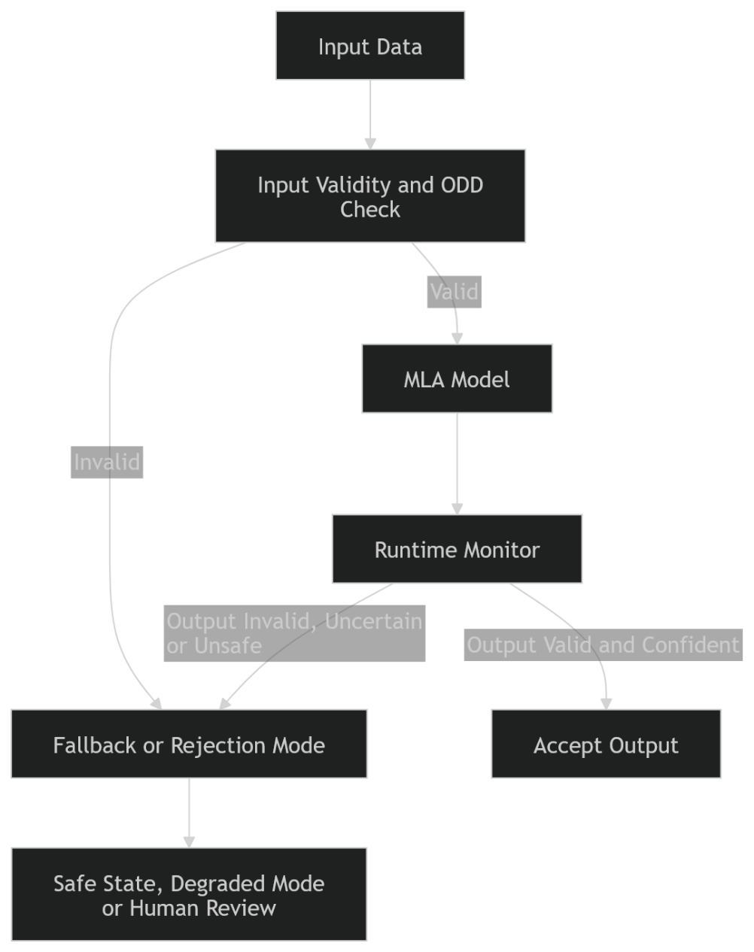
Operations and continued airworthiness
Certification is not the end of assurance activity
Monitor ODD excursions, confidence, uncertainty, rejection rates, fallback events and degradation trends.
When assumptions diverge, restrict, withdraw, retrain under formal change control or re-certify.
Online learning is not permitted for safety-related functions unless a specific certification basis has been agreed.
Operational data may support future improvement, but deployed behaviour must not change without authorised release control.
Action required: build the operational feedback loop now, but keep behavioural change behind configuration control.
Document runtime monitoring, no online learning and continued airworthiness sections, pp.26–30.
Ethical Assurance & Certification of MLA under DO-178C
17

Slide 18
Ethical and operational risk cannot be bolted on
Human oversight and security must be evidenced, not assumed
Human factors
Workload, time available, mode awareness, trust calibration, training, intervention feasibility
Security
Data poisoning, adversarial examples, model extraction, unauthorised retraining, compromised pipelines
Ethical assurance
Bias, transparency, contestability, accountability and proportionality of AI authority
“Human in the loop” is not a safety argument unless the system gives the human enough information, time and authority to intervene meaningfully.
Ethical Assurance & Certification of MLA under DO-178C
18

Slide 19
Need for action
A practical agenda for certifiable MLA
1
Engage the authority early and agree the certification basis.
2
Define MLA hazards, ODD limits and safety architecture before model development.
3
Implement an assurance-grade MLDevOps pipeline with repeatable evidence generation.
4
Package evidence by configured release: model, data, tools, environment and monitors.
5
Monitor in service and treat retraining as a formal configuration change.
Bottom line: the burden of proof remains with the integrator. If MLA cannot reduce risk, improve resilience, or provide capability unattainable by safer conventional means, it should not be adopted in a safety-critical function.
19

